Slide 1
Correlation Reversal Manipulation Revealed By
Benford’s Law and Random Forest
Poj Netsiri, TU Wien Data Science

Slide 2
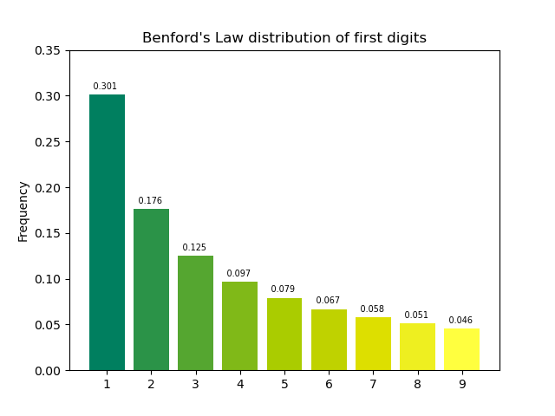
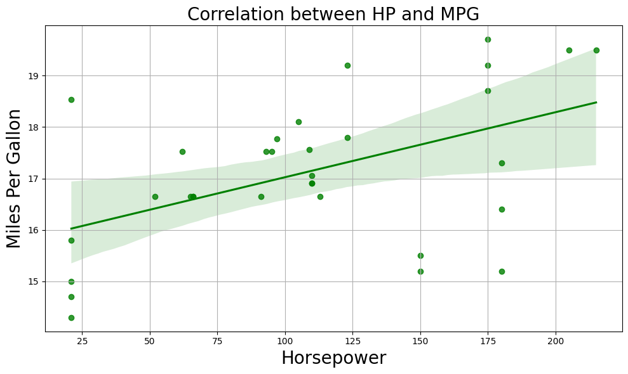

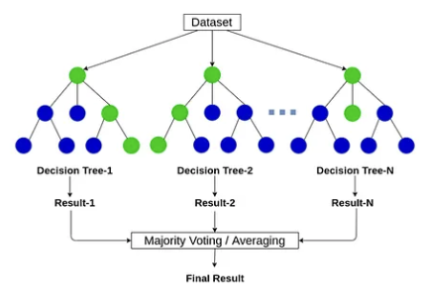
Q: Can we trust this data?
Benford’s Law
(Statistical Analysis)
Random Forest
(Machine Learning)
From the given data:
r = +0.5, p <0.001
“Cars with higher horsepower achieve better fuel efficiency”

Slide 3
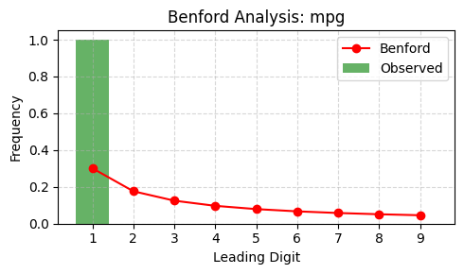
Using Benford’s Law to Detect Manipulation
Chi-square = 74.3017, p-value = 0.0000000000006
Criteria: Chi-square > 30.58 and p < 0.0001
Classified as manipulated (anomaly and extreme)

Slide 4
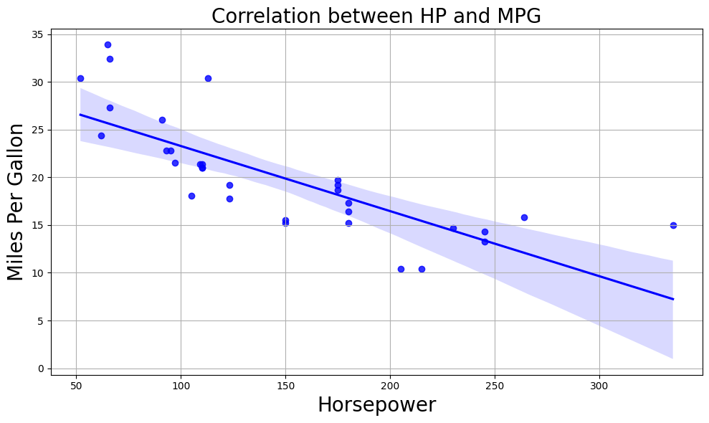
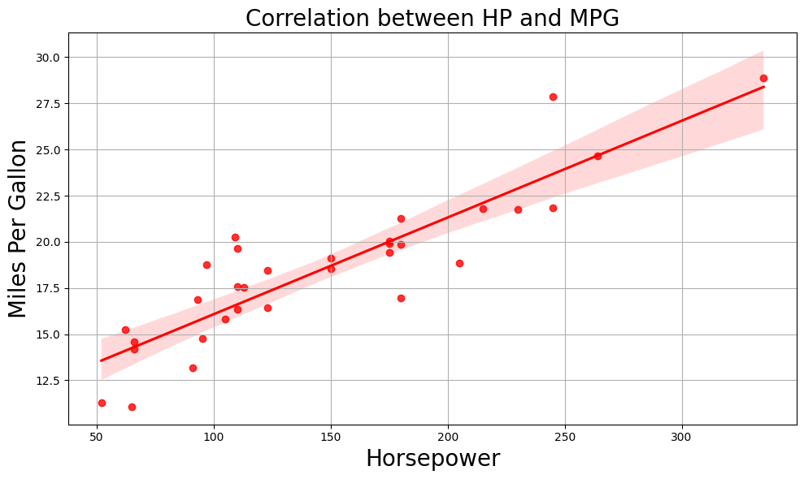
Using Random Forest to Detect Manipulation
Original Data (Label=0)
Supervised Training
Manipulated Data (Label=1)
RF Model
New Manipulated Data
Classifier
RF Model
Classified as manipulated

Slide 5
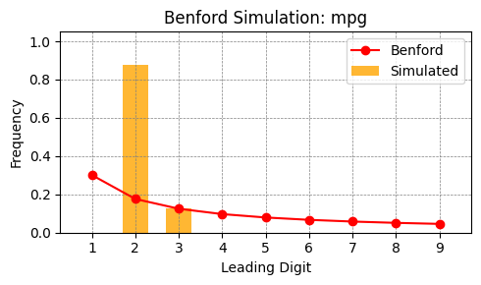
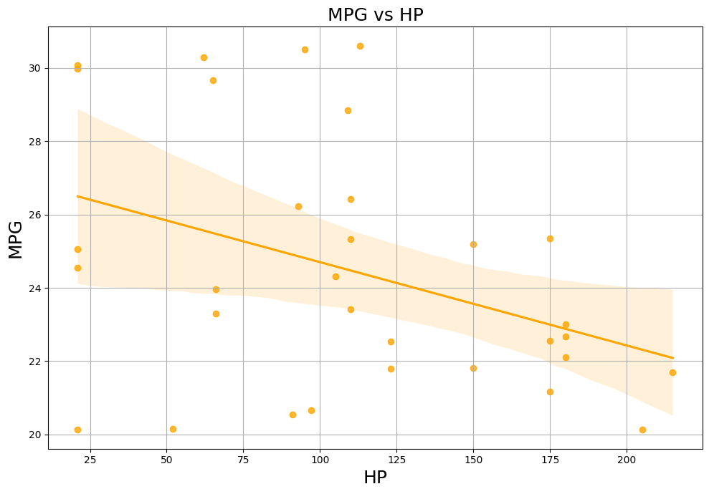
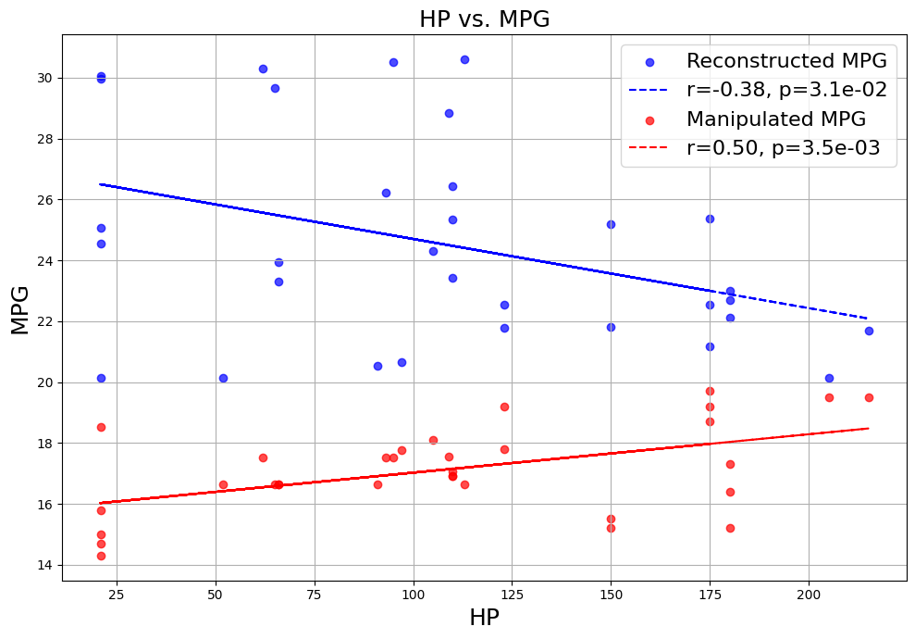
Using Benford’s Law to Detect Correlation Reversal
Stochastic Simulation
Reconstructed Data
Negative
Correlation

Slide 6
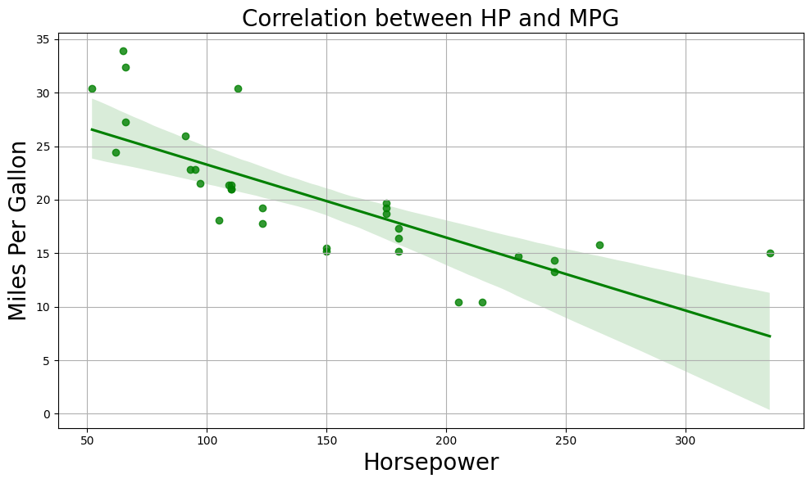
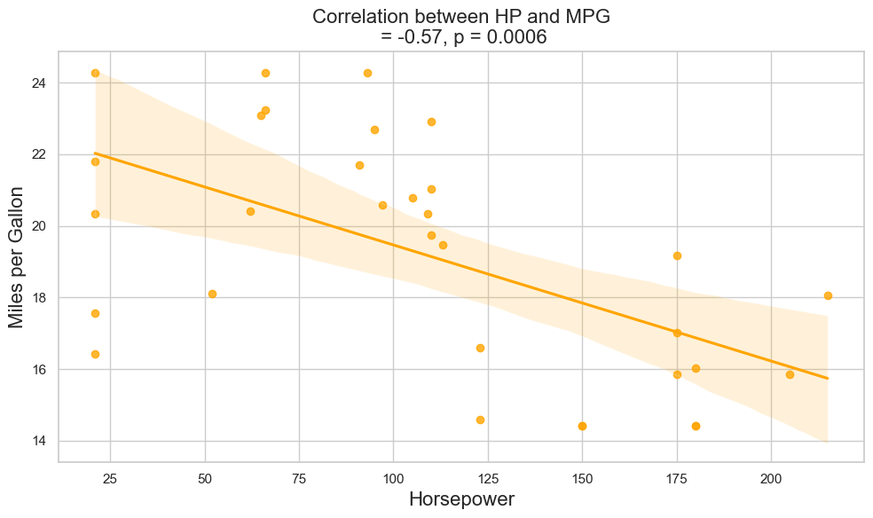
Using Random Forest to Detect Correlation Reversal
Original Data
Training
RF Model
Manipulated Data
Reconstructed Data
Regressor
Negative
Correlation
RF Model

Slide 7
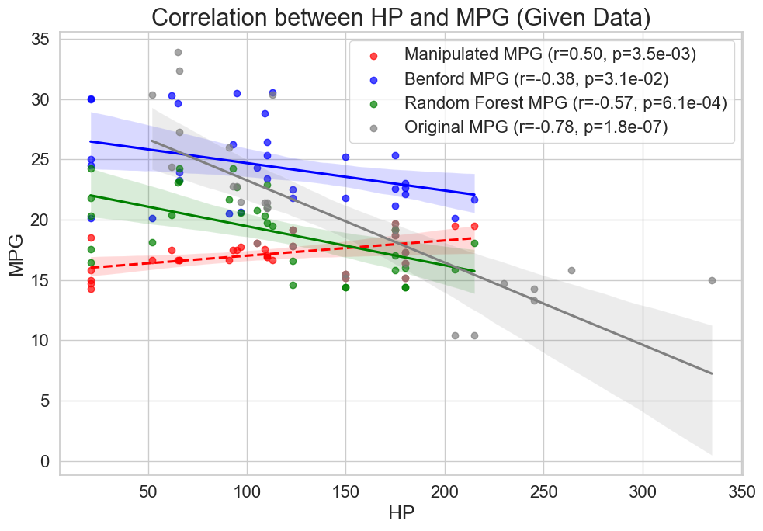
“Cars with higher horsepower actually
tend to have lower fuel efficiency.”

Slide 8
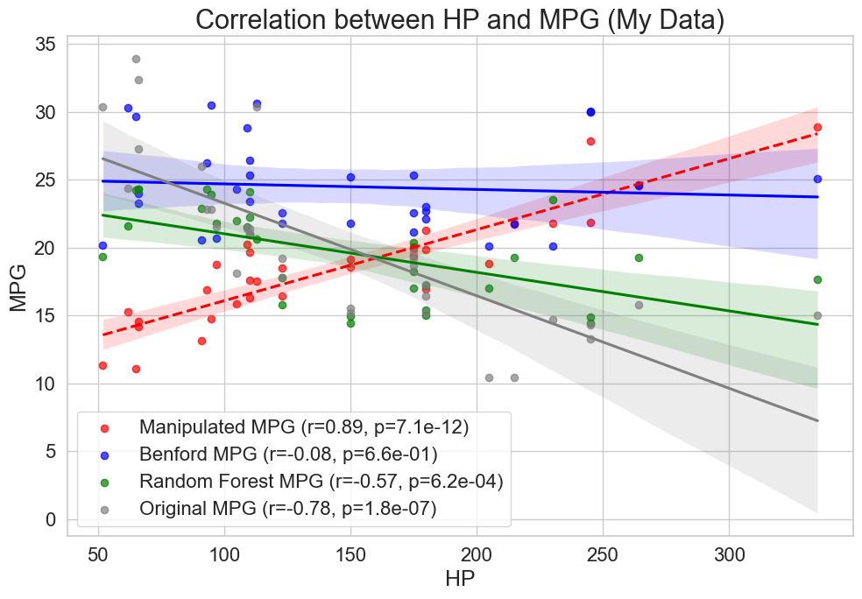
“Cars with higher horsepower actually
tend to have lower fuel efficiency.”

Slide 9
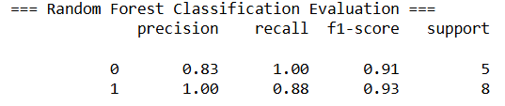
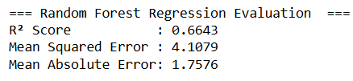
Evaluation of Random Forest Classifier and Regressor

Slide 10
Conclusion
1. Benford’s law can detect data manipulation and correlation reversal.
2. Random Forest Algorithm can also detect data manipulation
and correlation reversal.
3. Random Forest could approximate original data better
than Benford’s law (84% vs. 45%).
4. The original data was manipulated to show positive correlation
between HP and MPG while still p < 5%.

